Slide 1


Spatial representation of a virtual environment in a deep neural network
Boon Linn, Choo
Master Degree Defense @ July 03, 2020
Notes:
Hi, good day! I am Boon Linn. Today, I am going to present to you my master thesis on “Spatial representation of a virtual environment in a deep neural network”.
#################################################################################################################################
Hi: https://images.app.goo.gl/EfLUczb1VA64v7b37

Slide 2
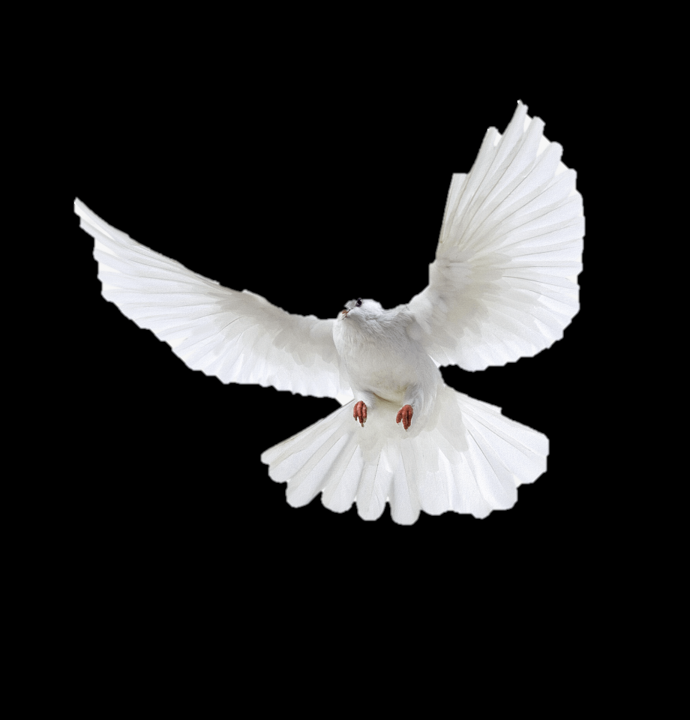

Notes:
I believe everyone here have been travelled abroad or visiting a new mall before, yet you still manage to find your route to get back to your hotel or retrieve your car.
Similarly, the animals are also capable of finding their ways to go home and foraging around for food and mating.
#################################################################################################################################
Background: https://images.app.goo.gl/bowNirL6uYhXFvpdA
Pigeon: https://images.app.goo.gl/YUkegYzU6xKVhN3o7

Slide 3
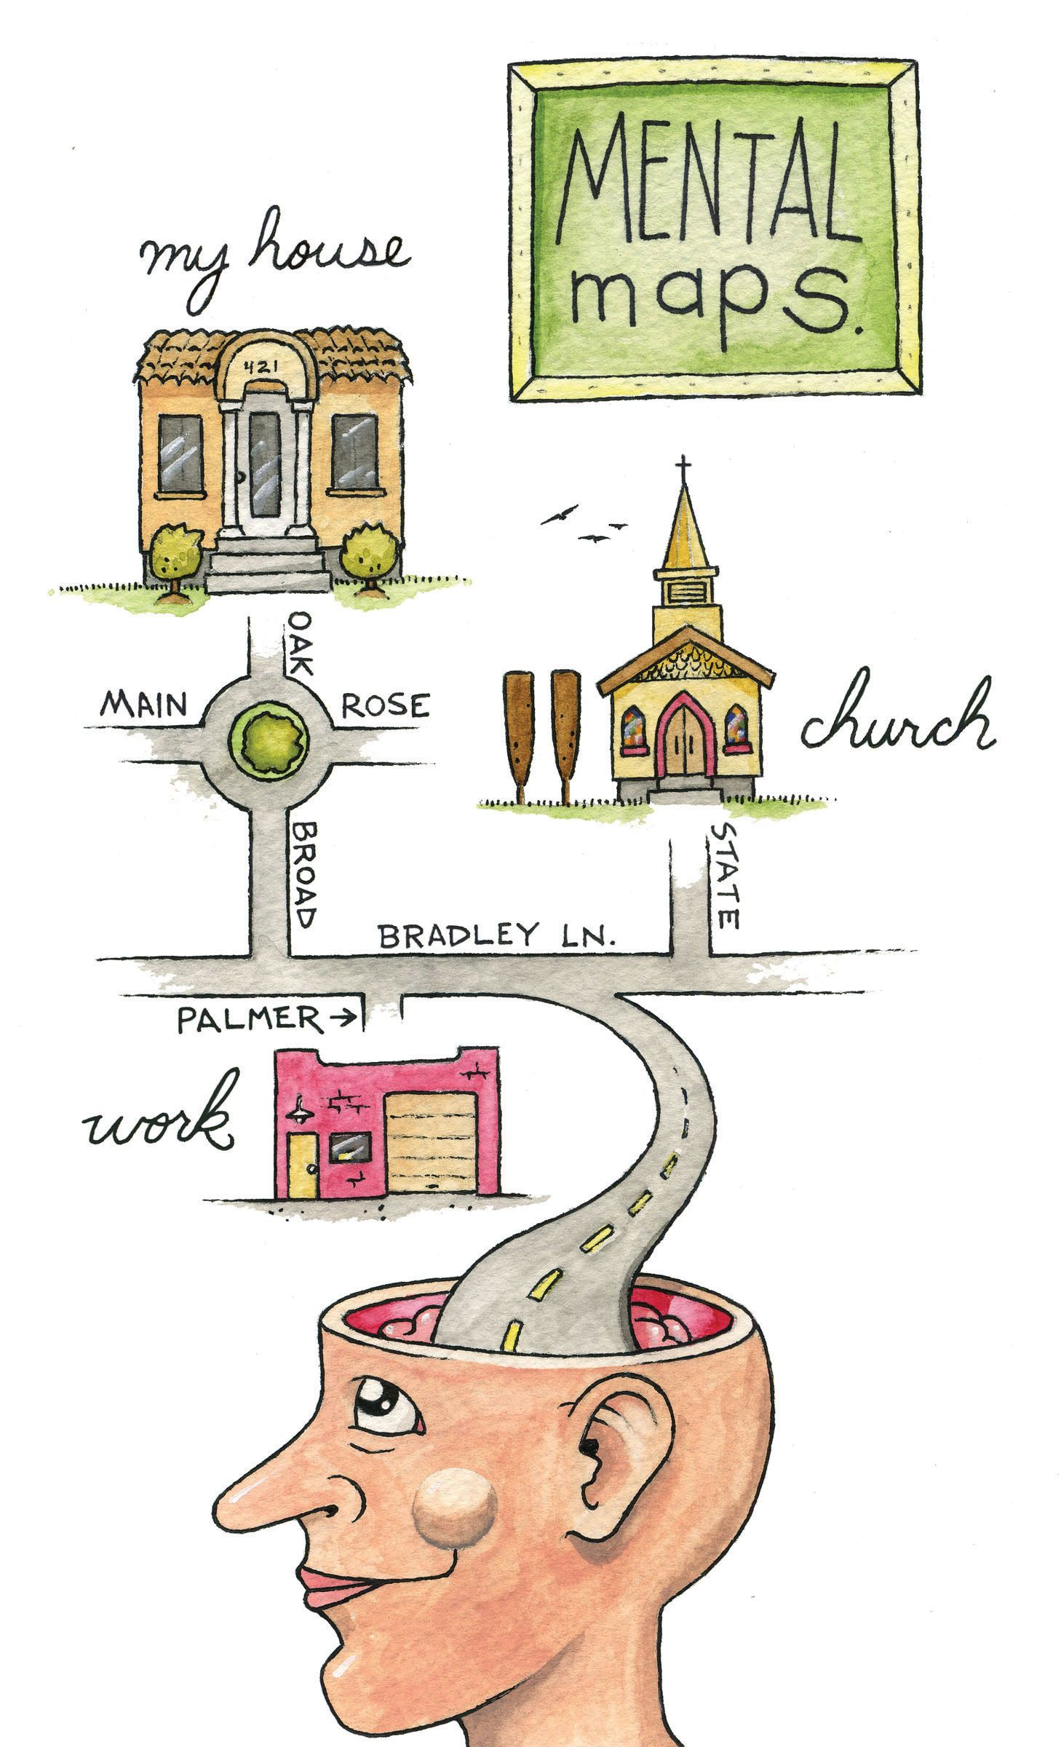

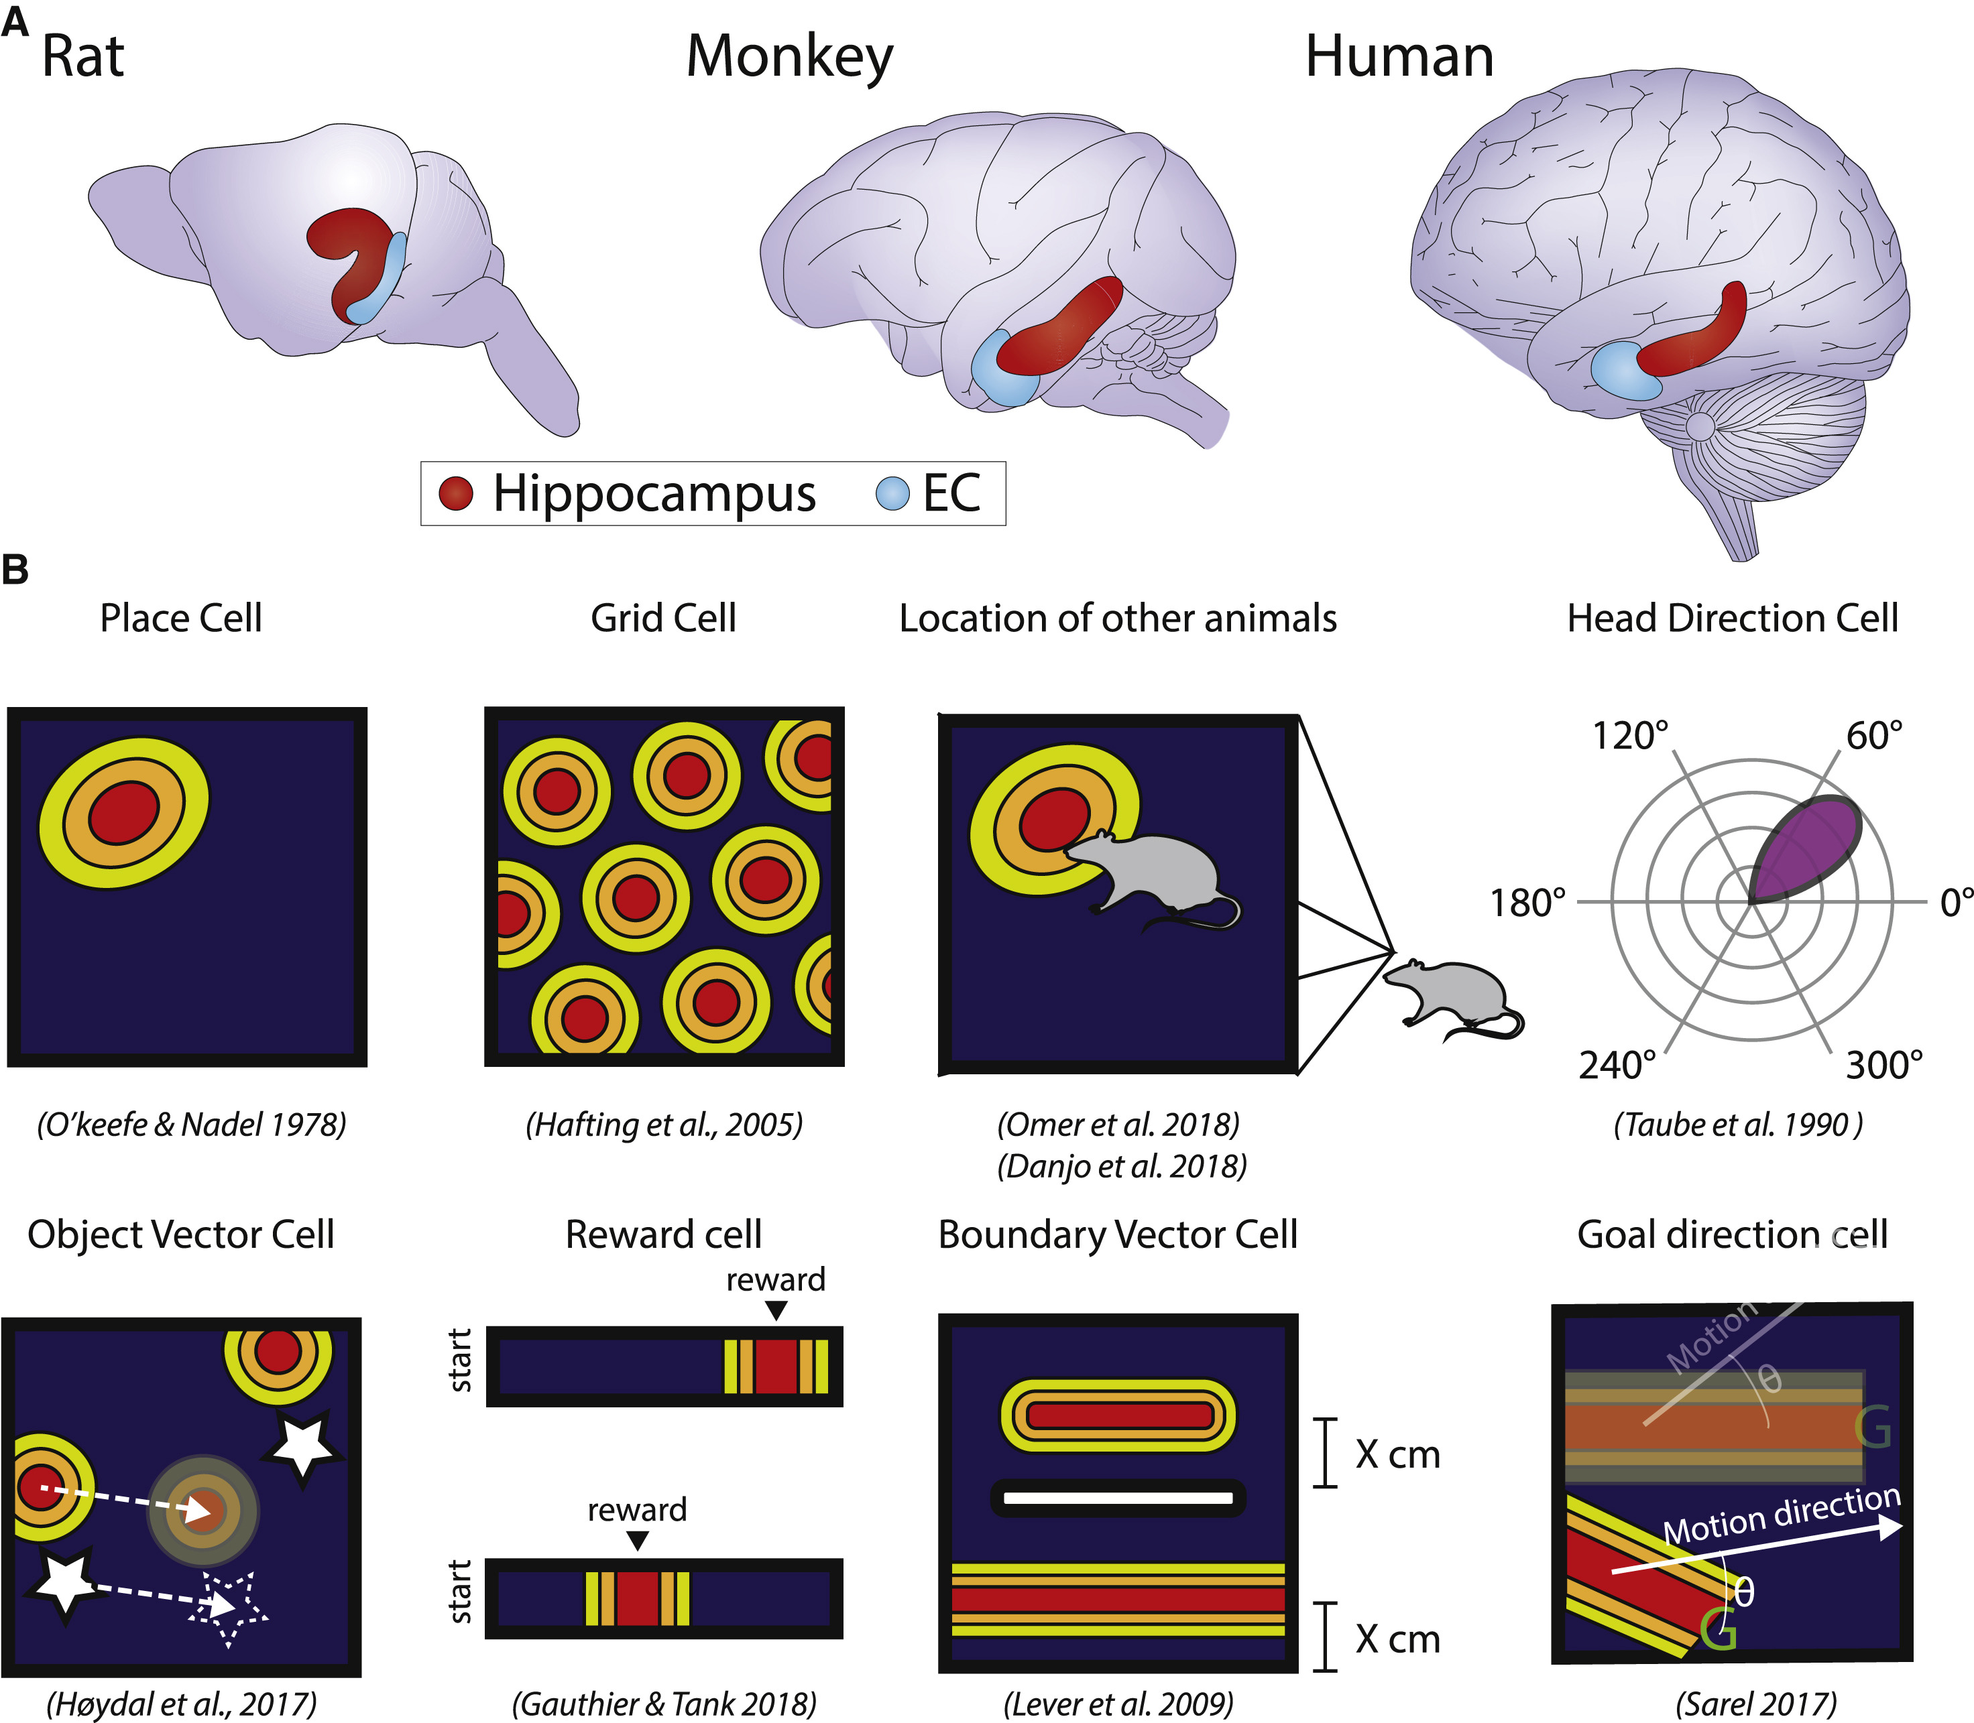
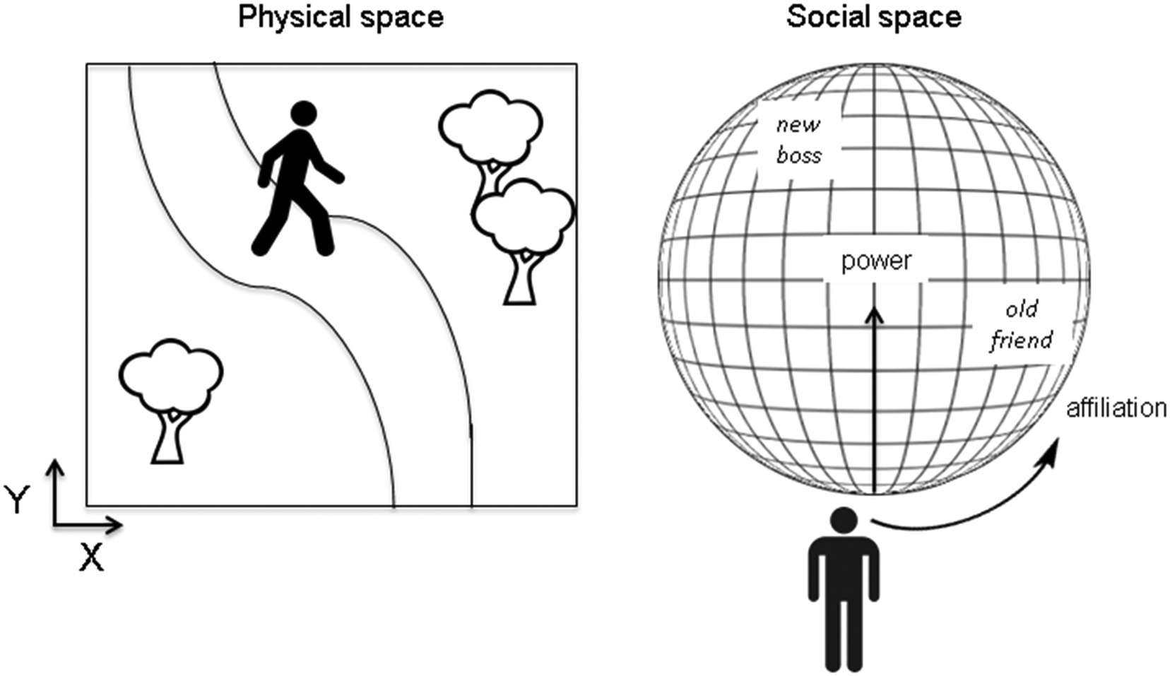
Introduction
(Behrens et al., 2018)
(Eichenbaum, 2015)
Notes:
This is thanks to the fact that we are having intrinsic instincts -- mental maps that wire our underlying spatial cognition.
And this spatial cognition is commonly known as cognitive map, which would also contribute to acquire, store, and recall memories.
These mechanisms are specifically allowed by spatial and directional cells which found
around the hippocampus and entorhinal cortex.
Which allow us to recognise landmarks and navigate as well as judging
physical and social spaces.
#################################################################################################################################
Right: https://images.app.goo.gl/8eEUGFPbyXcYT4Ak8
Top Left: http://www.animarom.ru/images/gif/gen_miro.gif (http://www.animarom.ru/pan_kaluga.html)

Slide 4
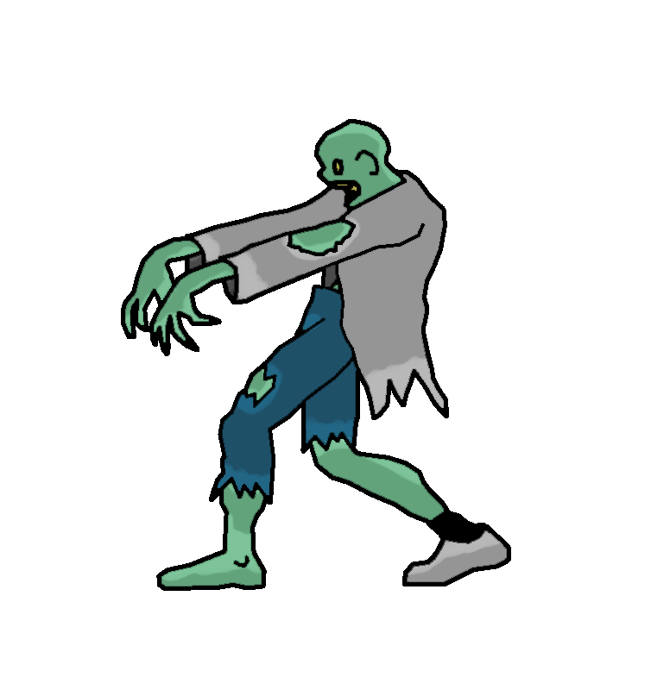
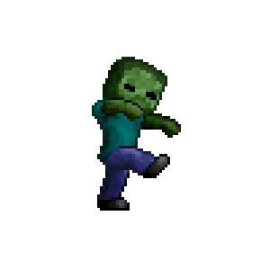
Notes:
These simple navigation tasks are however not the same for mobile robots which normally require heavy pre-training experience that involves high similarity with encounters during testing.
#################################################################################################################################
Bottom Right: https://images.app.goo.gl/z6vJE1Yusyw9AHd48
Top Centre: https://images.app.goo.gl/irPKNH5KmwfQVniX8

Slide 5
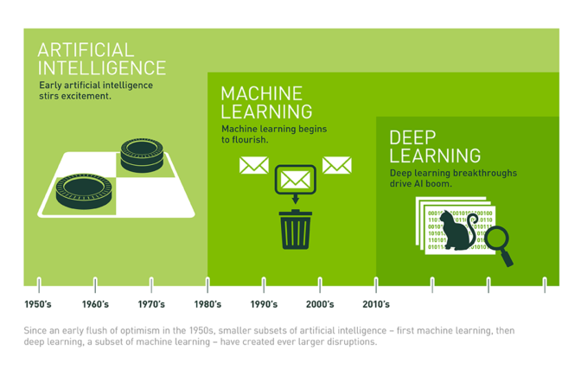
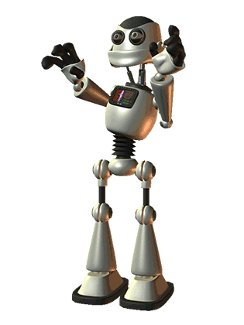
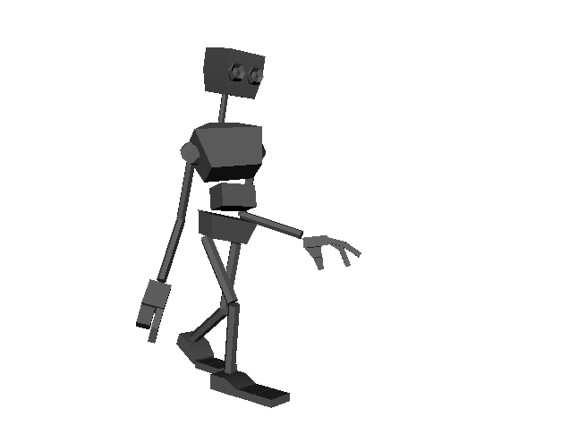
How do robots in real worlds and virtual world deal with navigation problems?
Capability to perform real time robotic mapping and odometry (estimation of position change with time based on perceived data such as motions via built-in sensors)
(Martin, 2019)
(Copeland, 2016)
Notes:
Entering the Deep Learning era, more approaches are developed trying to establish autonomous navigating robots. But then,
how do robots in real world and virtual world deal with navigation problems? Well, they must be able to perform real time robotic mapping and odometry! Yet, how do they do it?

Slide 6
Algorithm?
“Simultaneous Localization and Mapping (SLAM) is a commonly used method to help robots map areas and find their way”
Techniques: Probabilistic calculations
(Castellanos, Neira, & Tardós, 2004)
Notes:
Via SLAM (Simultaneous Localization and Mapping), a probabilistic calculation method that helps robots to map areas and navigate.

Slide 7
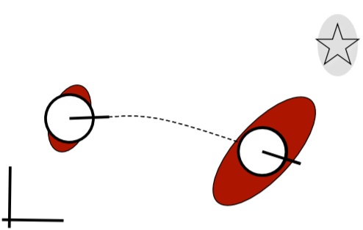
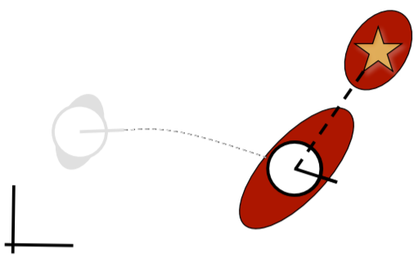
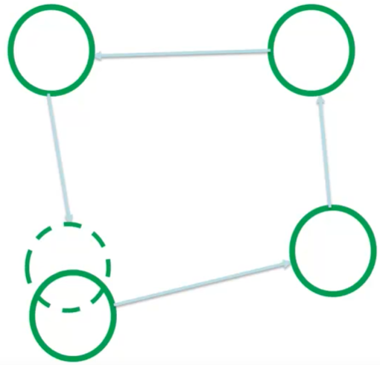
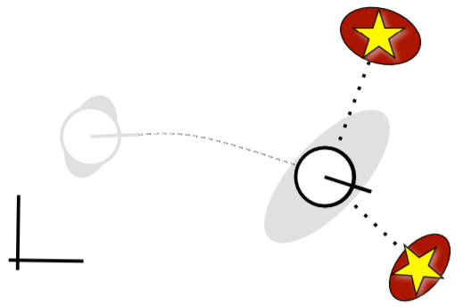
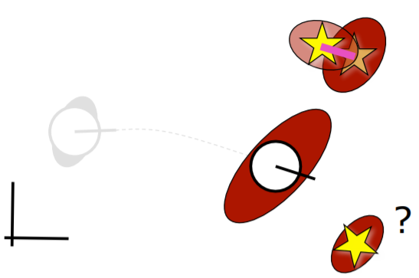
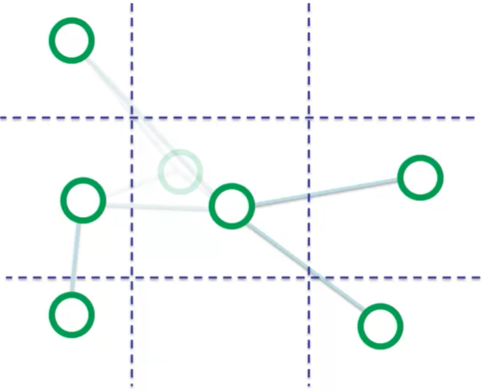
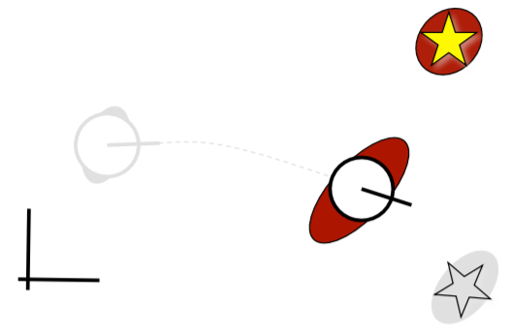
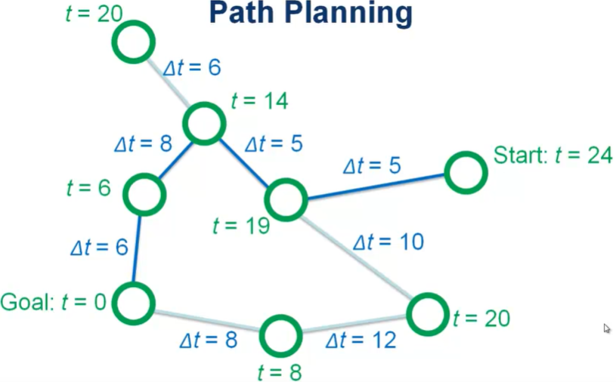
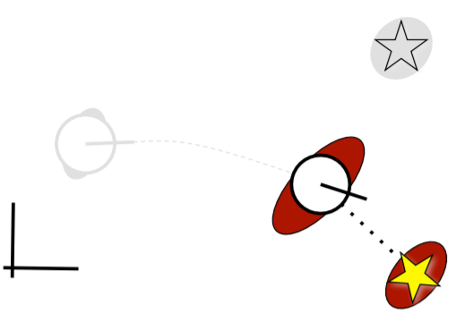
Visual SLAM ?
State prediction (odometry): Robot-landmark cross-covariance prediction
Measurement prediction: Global-to-local frame transform
Observation: (x,y)-point landmarks
Data Association & Correlation: Associates predicted measurements with observation and learnt maps (loop closure: )
Update: Filters update based on learned weights of convolutions
Integration of new landmarks
Graph Relaxation
average & loop closure
Map Pruning
1 location – 1 cell
Path Planning
Temporal
calculation
(Milford, 2012)
(Thrun, Burgard, & Fox, 1999; Siegwart & Nourbakhsh, 2004; Milford & Wyeth, 2008; Luft & Burgard, 2019)
Notes:
In particular, we would like to focus on visual SLAM today.
To navigate autonomously, the model needs to be able to perform self-localisation, path planning, map building and interpretation. And this will help the model to decide the steps to goal.
To be able to do so, the model will need different abilities of calculation that do the measurement works such as state prediction, measurement prediction, observation, data association & correlation, filters update and integrate these into its internal learning map.
What makes the SLAM more successful is its ability to perform graph relaxation, map pruning and path planning.
These good approaches can be integrated into simulating the biological processes

Slide 8
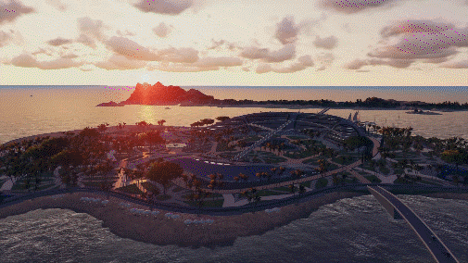
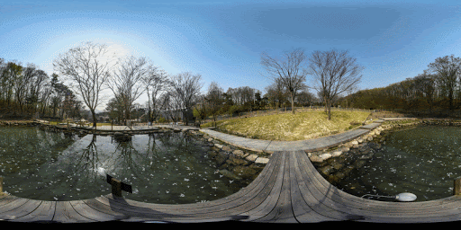
FABMAP2
SeqSLAM
ViTa-SLAM
(Cummins & Newman, 2009)
(Milford & Wyeth, 2012)
(Struckmeier at al., 2019)
CAT-SLAM
RatSLAM
(Maddern, Milford, & Wyeth, 2012)
(Milford, Wyeth, & Prasser, 2012)
Notes:
Specifically, RatSLAM was inspired by SLAM and empirical research on the rodent hippocampal cognitive map.
And have given rise to a variant of the model such as FABMAP2, SeqSLAM, ViTa-SLAM and CAT-SLAM, which have surpassed some ability of the traditional robots.
For example, able to match images of the same place in different seasons and weathers.
#################################################################################################################################
http://www.lifelong-navigation.eu/files/naseer14aaai.pdf
Bottom Right: https://images.app.goo.gl/PjrRxYTEENChmjTP8
Bottom-Center Right: https://images.app.goo.gl/cbUMZdYSXM2KLSDSA
Bottom Left: https://images.app.goo.gl/kNWdR6ndkUJbuUAc9

Slide 9
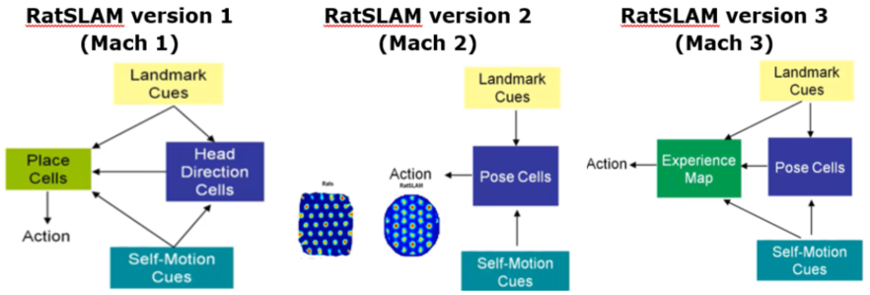
Rat-SLAM
2D Attractor Network (Boundary Problems)
3D Attractor Network (Grid Cells = Pose Cells, Collision & Discontinuity Problems)
Continuous, Reusable Map for Navigation
(Milford, 2012)
Notes:
The very first model of RatSLAM was built to take landmark cues to support its pose hypotheses which are represented by the place cells (position) and head direction cells (orientation) in two separate networks as well as to update the estimation (self-motion cues). The model however encountered difficulties in 2D environments due to the inability to hold multiple pose hypotheses whereby it will face boundary problem around the edge.
Hence, they combined place and head direction cells into one single network, pose cells, which however found to encounter goal recall breakdown due to collision and discontinuity. Collision means 1 pose cell representing >1 place; and discontinuity means >1 pose cells representing the same location
The team realized that this is due to the shortcoming of the model which could not form an experience. Hence, they came up with a third version of RatSLAM which supports this experience map feature. An experience is a matched activity pattern of pose and local view cells. Any difference in the pairings would lead to the formation of new experience that is linked to previous experience (node) via the distance obtained from self-motion cues and corrected via loop closure. This model provided the robot with a continuous and reusable map for navigation.

Slide 10
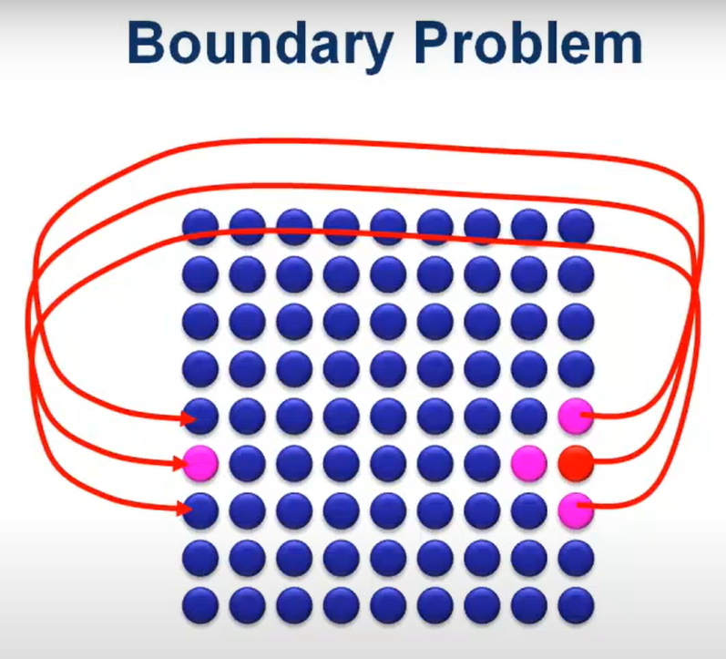
RatSLAM V1: Boundary Problem
“If the rat or the robot keeps heading in one direction for a very long period of time, the activity or cluster of energy in the network is eventually going to hit one of the boundaries of that layout of neurons or units, and one way to solve this which has been come up with by quite a few papers is to use wrapping connectivity in your network. So, what you do is you connect the cells from one boundary of your network all the way back to cells on the opposite boundary of your network and what this does in effect is causes activity or a cluster of activity when it hits one boundary of the network. It will wrap around or circle around and re-enter on the opposite side and that means that the activity will never disappear off the edge, it will just come back on the other side so this is one of the common ways of solving this problem.”
(Milford, 2012)
Notes:
https://www.youtube.com/watch?v=t2w6kYzTbr8

Slide 11
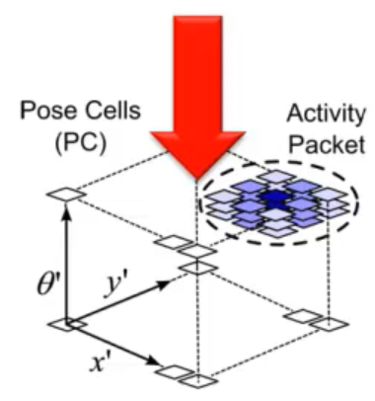
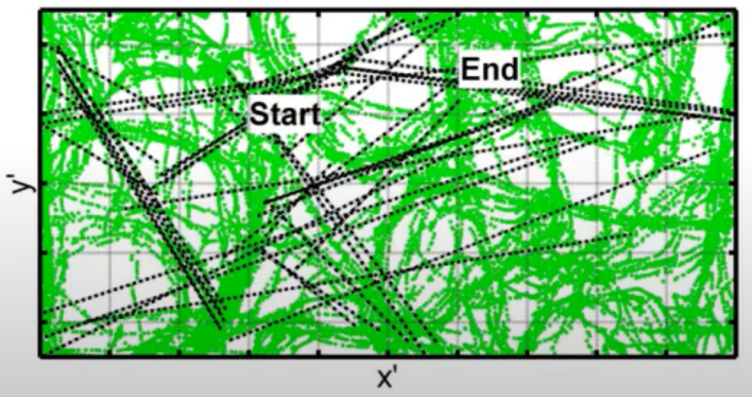
RatSLAM V2: Pose Cells, Collision & Discontinuity Problems
Topology of pose cell network no longer reflects topology of physical world:
“When expanded the environment size and ran the experiments over much longer period of time (1-2hrs), trying to do effective navigation between points, it was found that the robot was unable to navigate successfully. Over the course of an entire experiment, you were to look down from up on above at the pose cell network and track the location of the biggest or most dominant cluster of active cells over the entire experiment and plot a green dot on a graph for every second of the experiment. Every green dot represents where the dominant activity packet was in the XY plane of the pose cell network. The black dashed lines represent real localization or recalibration events. So, these were situations in which the robot saw a distinct visual scene and started to inject activity into the network that was somewhere very different to where the current dominant activity packet was and with enough visual evidence that the location where it was injecting activity would actually form its own activity packet which would eventually become dominant. This method is known as recalibration or errors correction. The implication of this is that there are lots of discontinuities in this pose cell networks. So, the layout of the pose cell network which initially represented quite nicely the XY layout of the environment however rapidly becomes less and less representative of the actual physical layout of the environment due to these discontinuities, and the end effect of this is that you can no longer interpret the pose cell network as representing directly the physical layout or structure of the environment which leads to ineffective navigation”
(Milford, 2012)
Notes:
https://www.youtube.com/watch?v=t2w6kYzTbr8

Slide 12
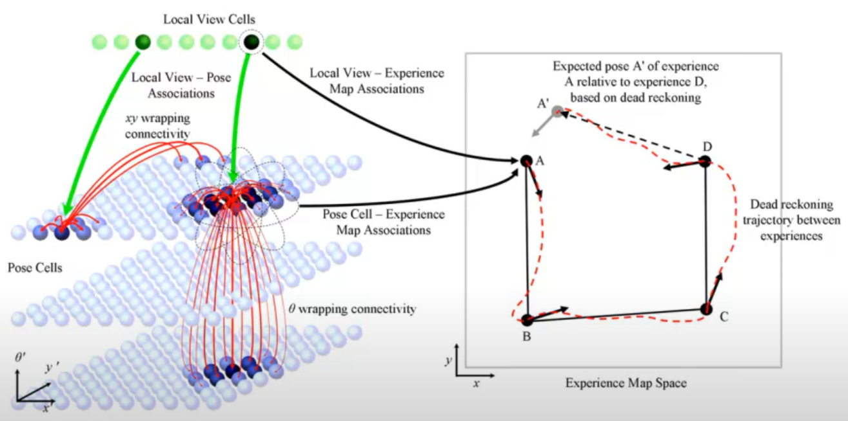
RatSLAM V3
(Milford, 2012)
Notes:
https://www.youtube.com/watch?v=t2w6kYzTbr8

Slide 13
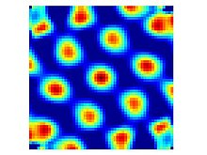
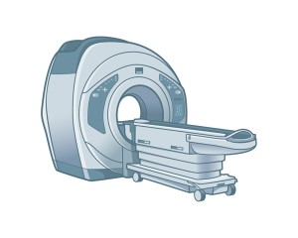
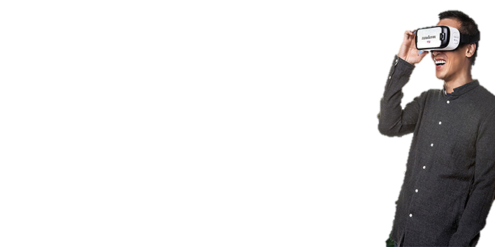
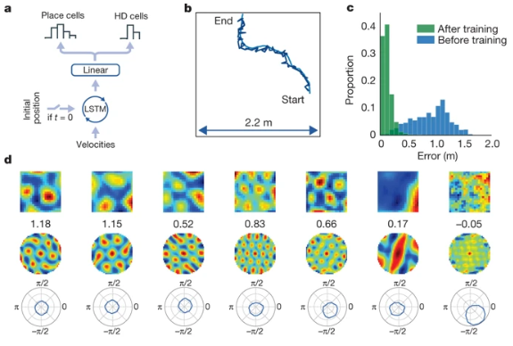
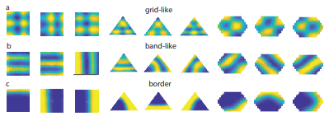
(Banino et al,, 2018)
(Cueva & Wei,, 2018)
Notes:
These prior successes do not stop scientists like you and young researchers like me
Neuroscientists have previously tried using Virtual Reality alongside with fMRI studies and found grid cell-like representations
Some of them such as Banino and Cueva have also tried to investigate path integration in simulated agents with recurrent neural networks (RNNs) and similarly found grid representations, along with other types of spatial cells
#################################################################################################################################
Top Right: https://images.app.goo.gl/wiuCxg6p5Tj9FCvJ6
Centre (Grid): https://images.app.goo.gl/UUpzFeYKoKVdaxcr6
Left: https://images.app.goo.gl/UJ1dJwTjt7ZtQtvC6 (from Banino)

Slide 14


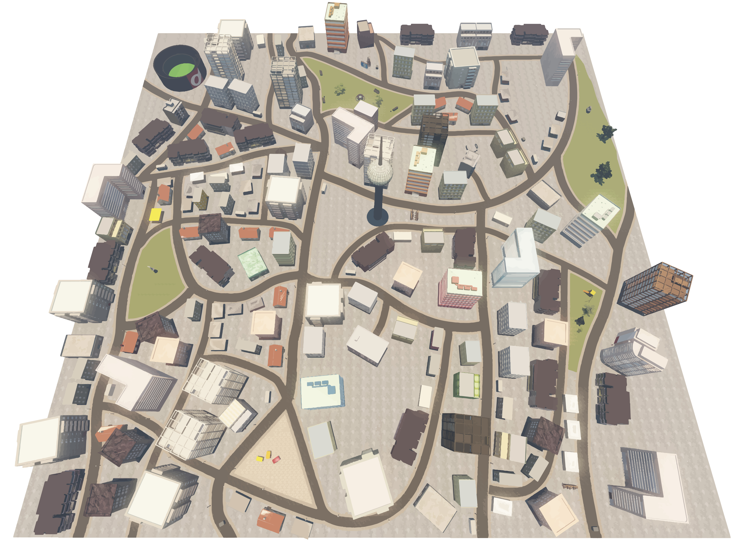
Research Questions
Can we train a neural network to learn in a virtual environment? How?
In particular: What will be utilized to recognize the position in Donderstown?
Which type of deep neural network to be used? Why?
Spatial Cognition
SLAM
Virtual Environment (Donderstown)
Deep Neural Network
(Bellmund, Deuker, & Doeller, 2018)
Notes:
Summing what previously mentioned, our team also have a lab-built virtual environment known as Donderstown, which was used by Bellmund and Deuker who have discovered grid-like representation in their VR-fMRI navigation studies. The Donderstown was built using UDK (Unreal Development Kit) and was largely influenced by the old-style German town design.
Alongside, per inspired by the findings in spatial cognition and improvement of SLAM, we wonder if we can train the neural network using just the snapshots from Donderstown?
While we are asking these, we wonder how do we let the positions of Donderstown getting uncovered by the neural network?
Besides, we must also determine the right type of deep neural network to be used.

Slide 15
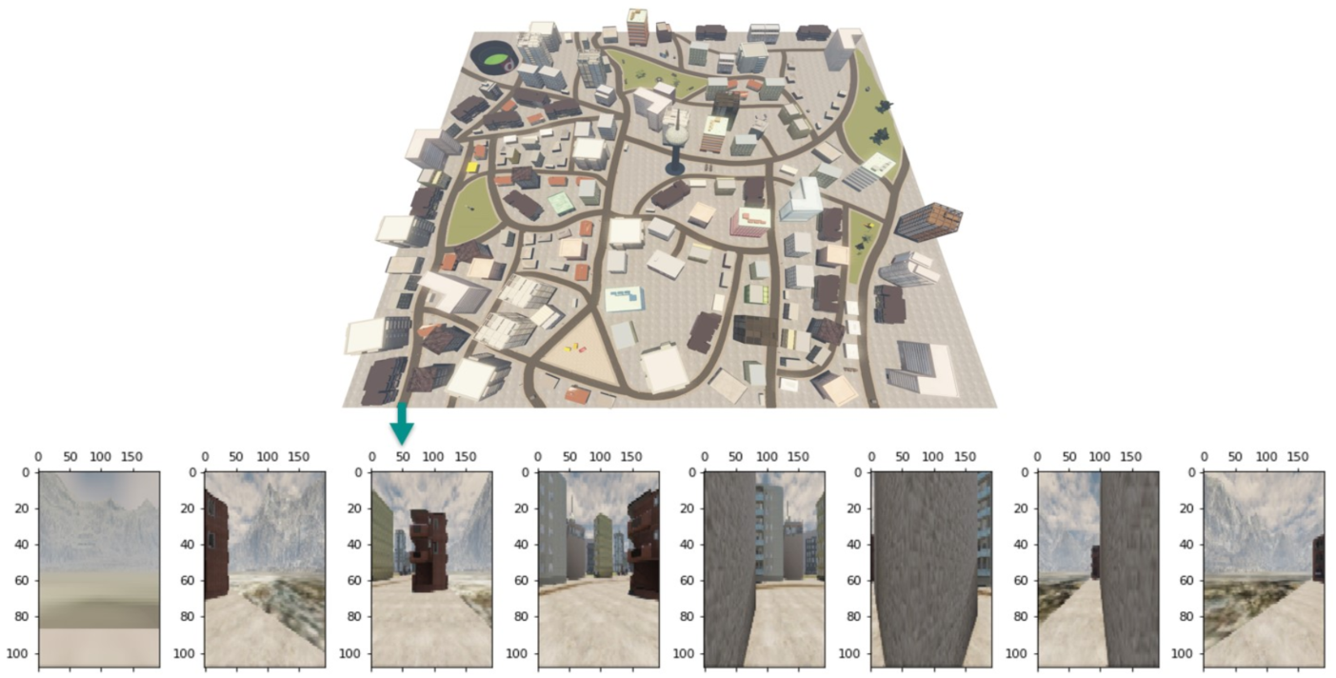
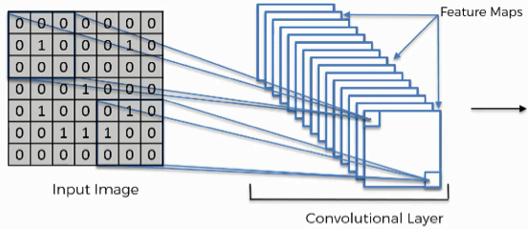
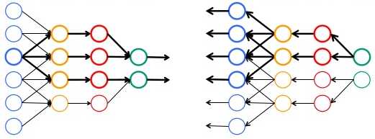
Methods: DNN & Raw Data
Convolutional Neural Networks
…
EFFECTIVE for image processing
Feedforward & Backpropagation
(Mishra, 2019)
(Rawat & Wang, 2017; Gu et al., 2018)
652720
1st – person perspective
0°/360°,45°,90°,135°,180°,225°,270°,315°
Notes:
After some evaluation, we decided to build a
deep convolutional neural networks (CNN) to process our Donderstown’s snapshots. This is because CNN are
Effective for image processing and able to learn the detailed input features via both
Feedforward and backpropagation. This coupling allows one to find out the values of the hidden layer as well as enabling weighted learning
One special thing about CNNs is that CNN nodes are only connected to a small region from previous layers, which helps to reduce overfitting.
Using 652,720 non-uniform snapshots covering Donderstown at 8 different angles which differ by 45° in 1st person view at ground level as our raw data,

Slide 16
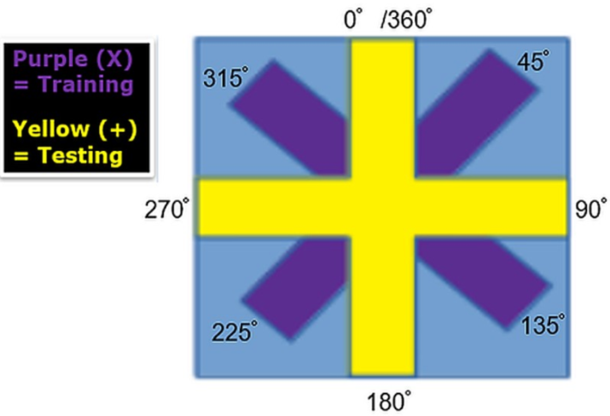
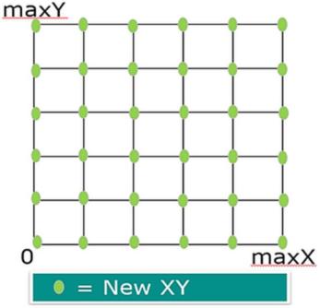
Methods: Data Pre-processing
Notes:
And taking the maximum X and Y positions, we first divided the map into 25 even grids to obtain new XY coordinates.
Original coordinates which are closest to the newXY are then selected.
This step is mainly to prevent the model from being biased towards one specific coordinate in the virtual environment.
In the data pre-processing, we also distribute alternate angles into training (X) and testing (+) data.

Slide 17
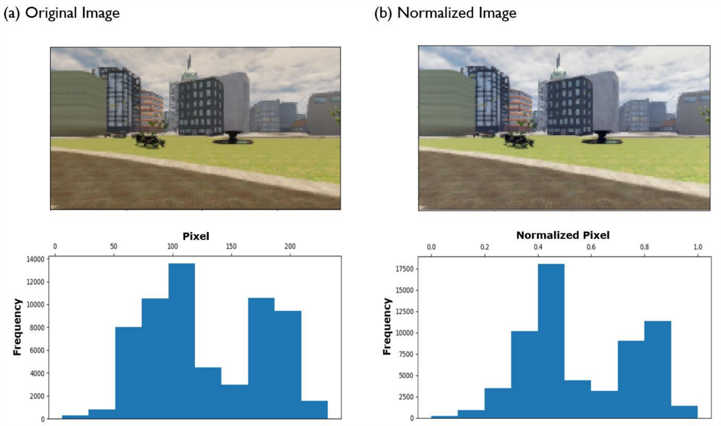
Methods: Data Pre-processing
Notes:
Thereafter, the selected data are normalized and rescaled into 0 to 1 range to speed up the training process.

Slide 18
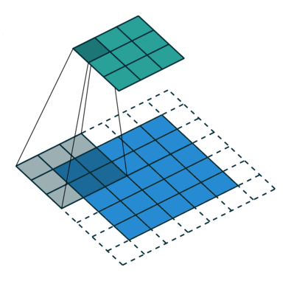
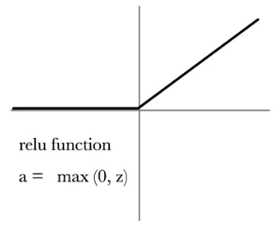
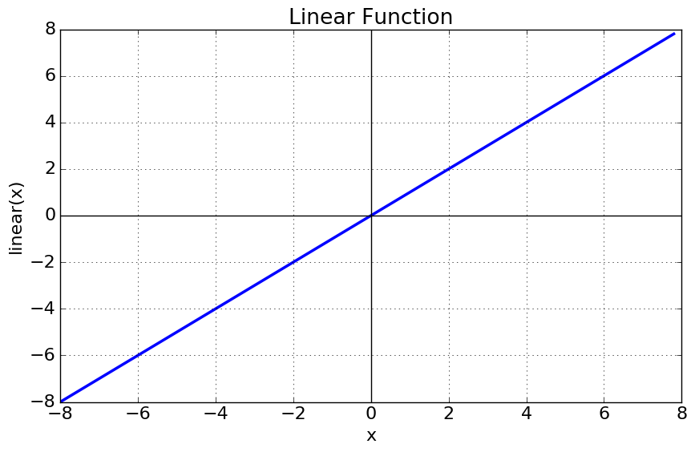
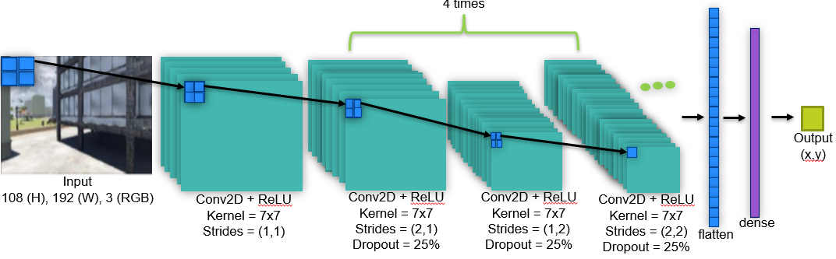
Methods: Model Architecture
4 times
Notes:
Using the original size of input, we feed the selected data into our model that composed of 13 Conv2D layers that have a kernel size of 7x7 to segment and correlate the features in the data. We also included dropout and stride in the layers to reduce overfitting and to speed up the training.
These convolved features are eventually being flatten and vectorized to predict the xy output.
Same padding is used to ensure the input and output (images) are having the same sizes.
And to your acknowledgement, we used relu activation which would turn negative inputs into 0 in the convolution layers and linear for the dense layer.

Slide 19
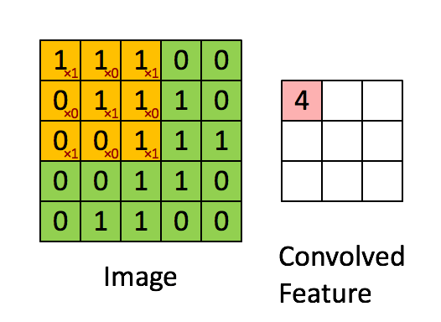
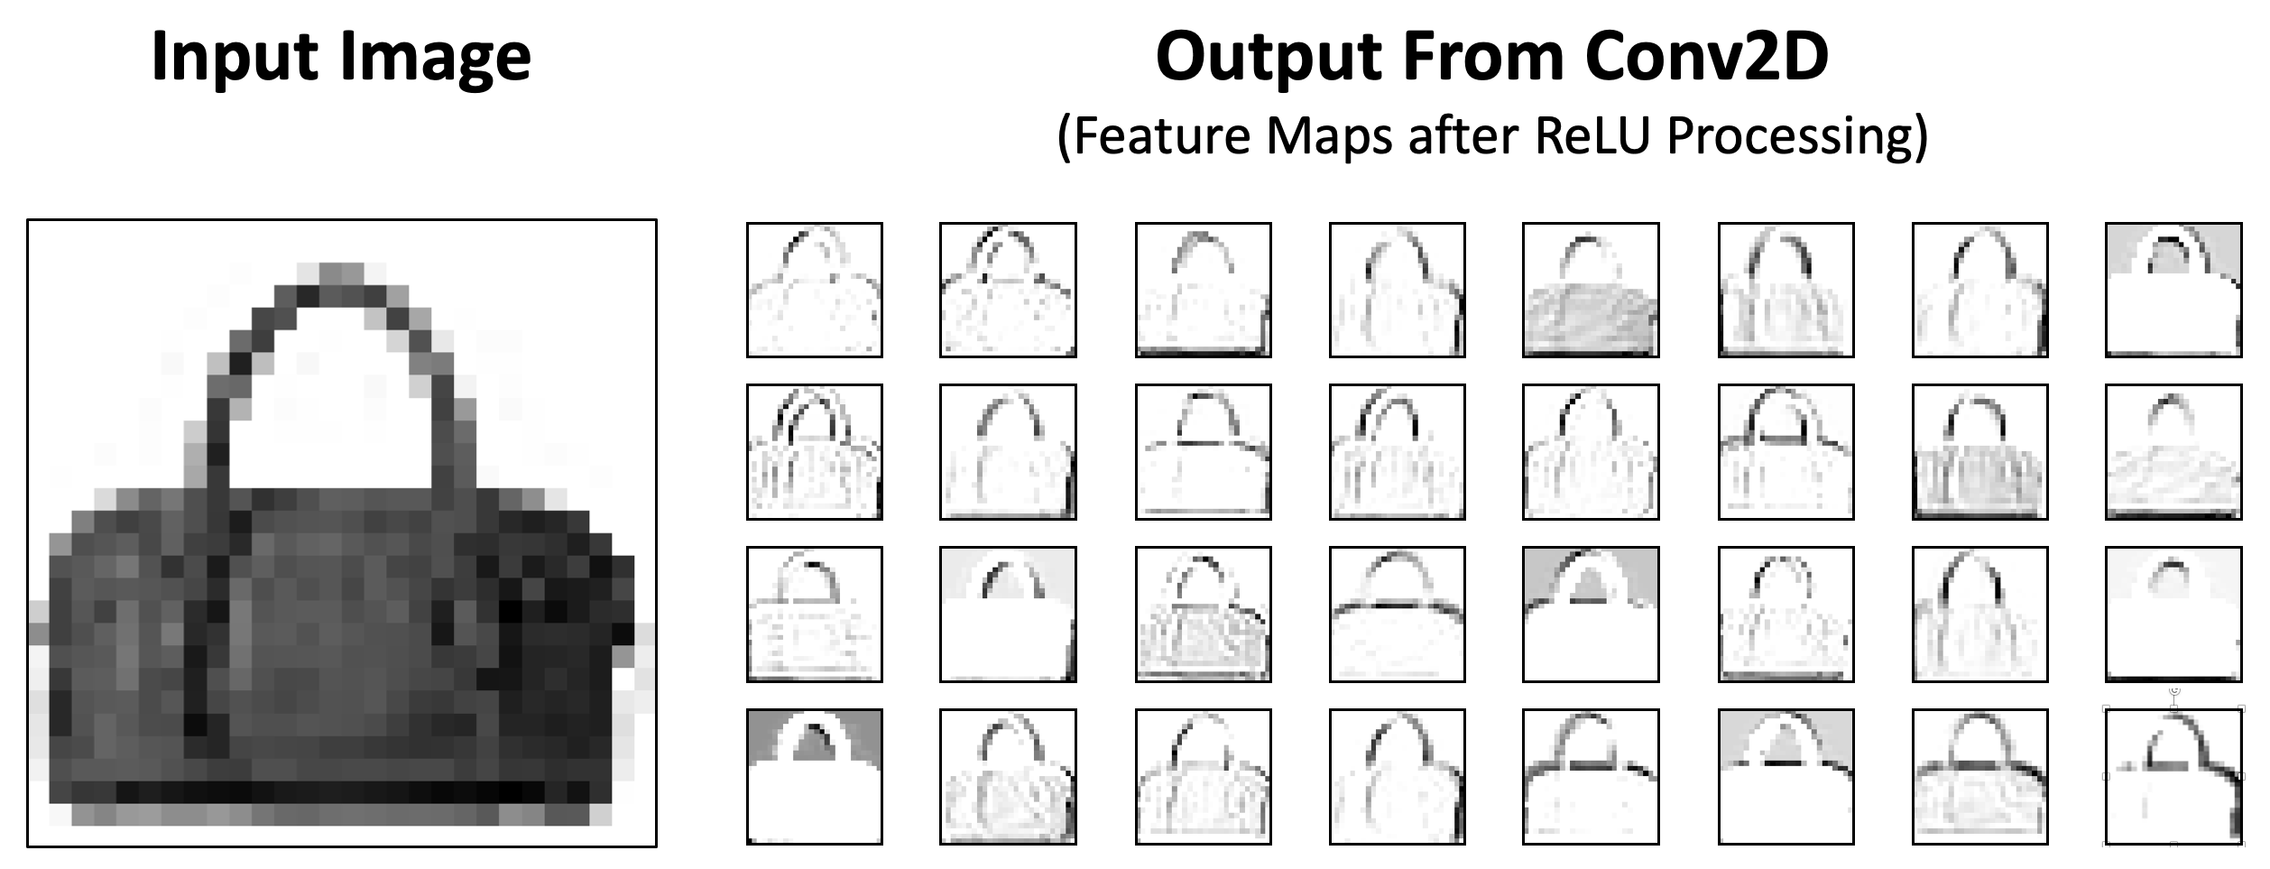
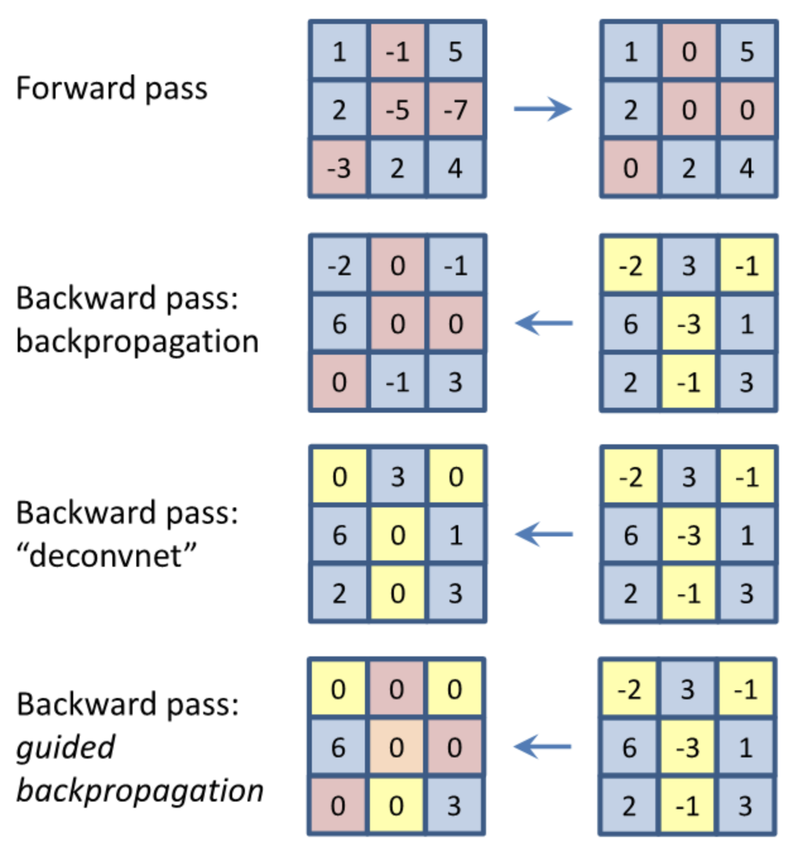
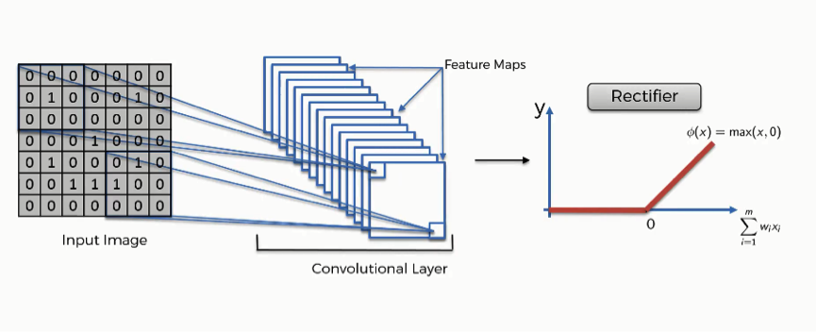
Methods
Notes:
Since we are using a Conv2D, kernel = filter. It is a mask or convolution matrix of weights that help to classify, segment and correlate features in the data.

Slide 20
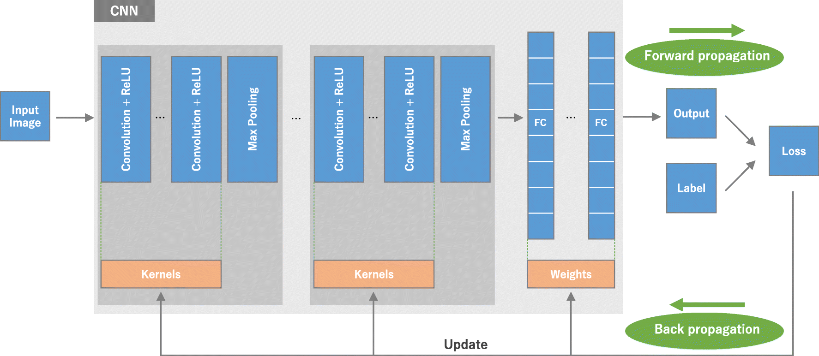
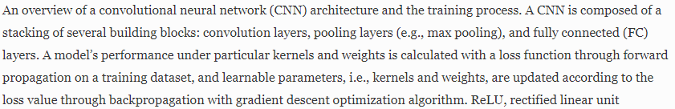
Methods
(Yamashita et al., 2018)
Notes:
https://link.springer.com/article/10.1007/s13244-018-0639-9

Slide 21
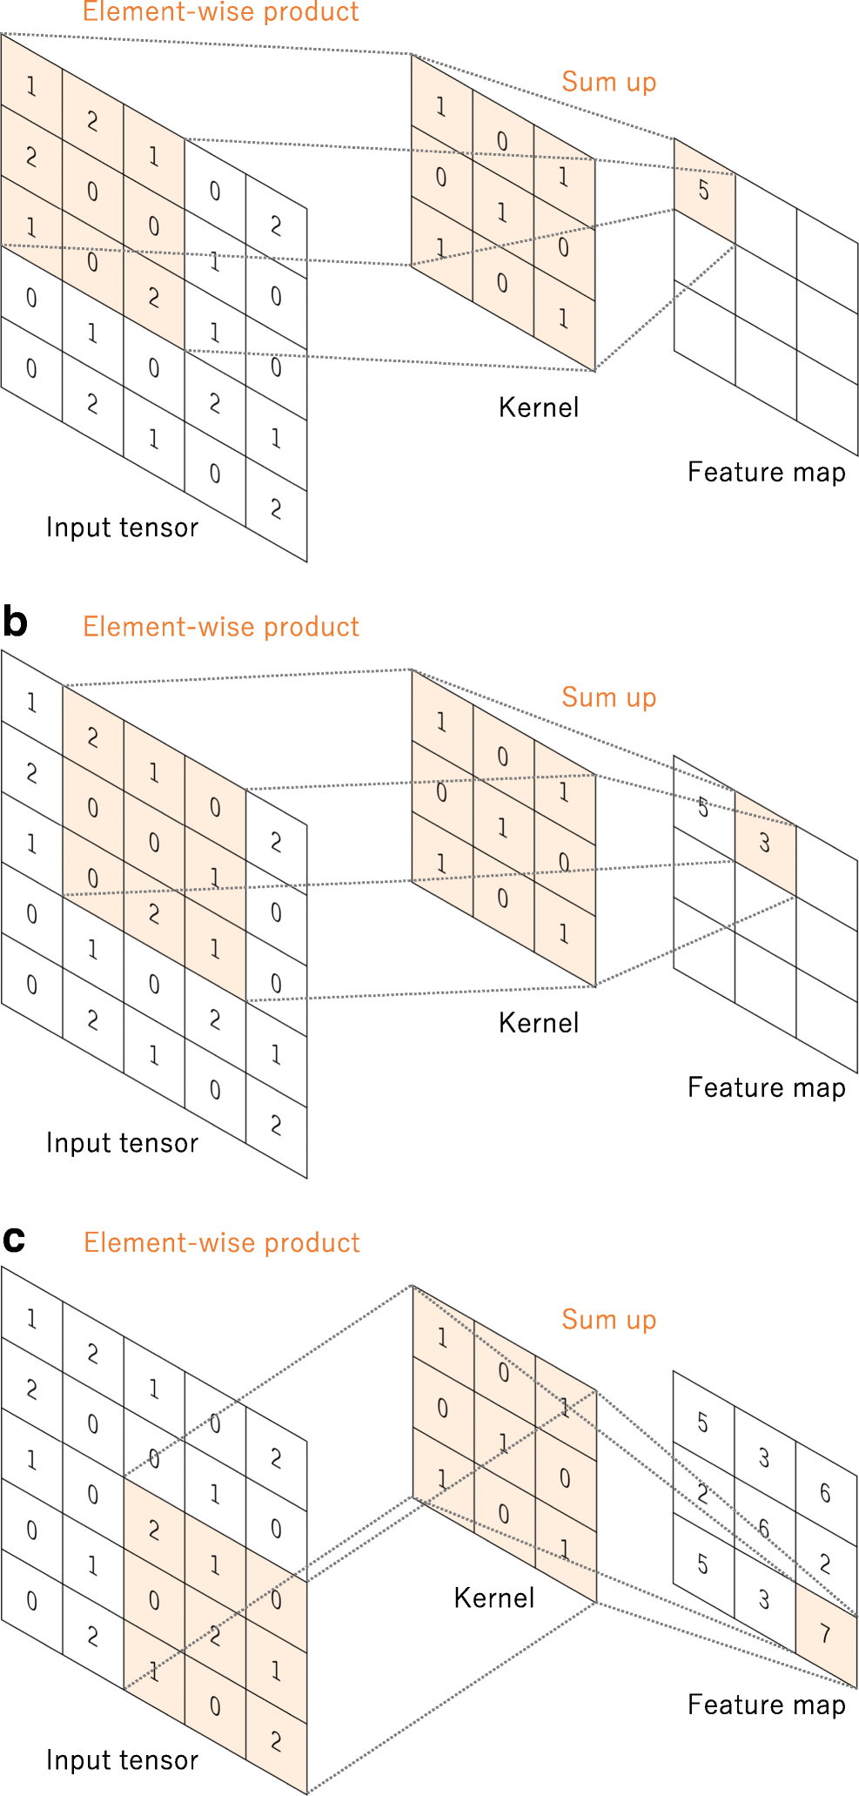
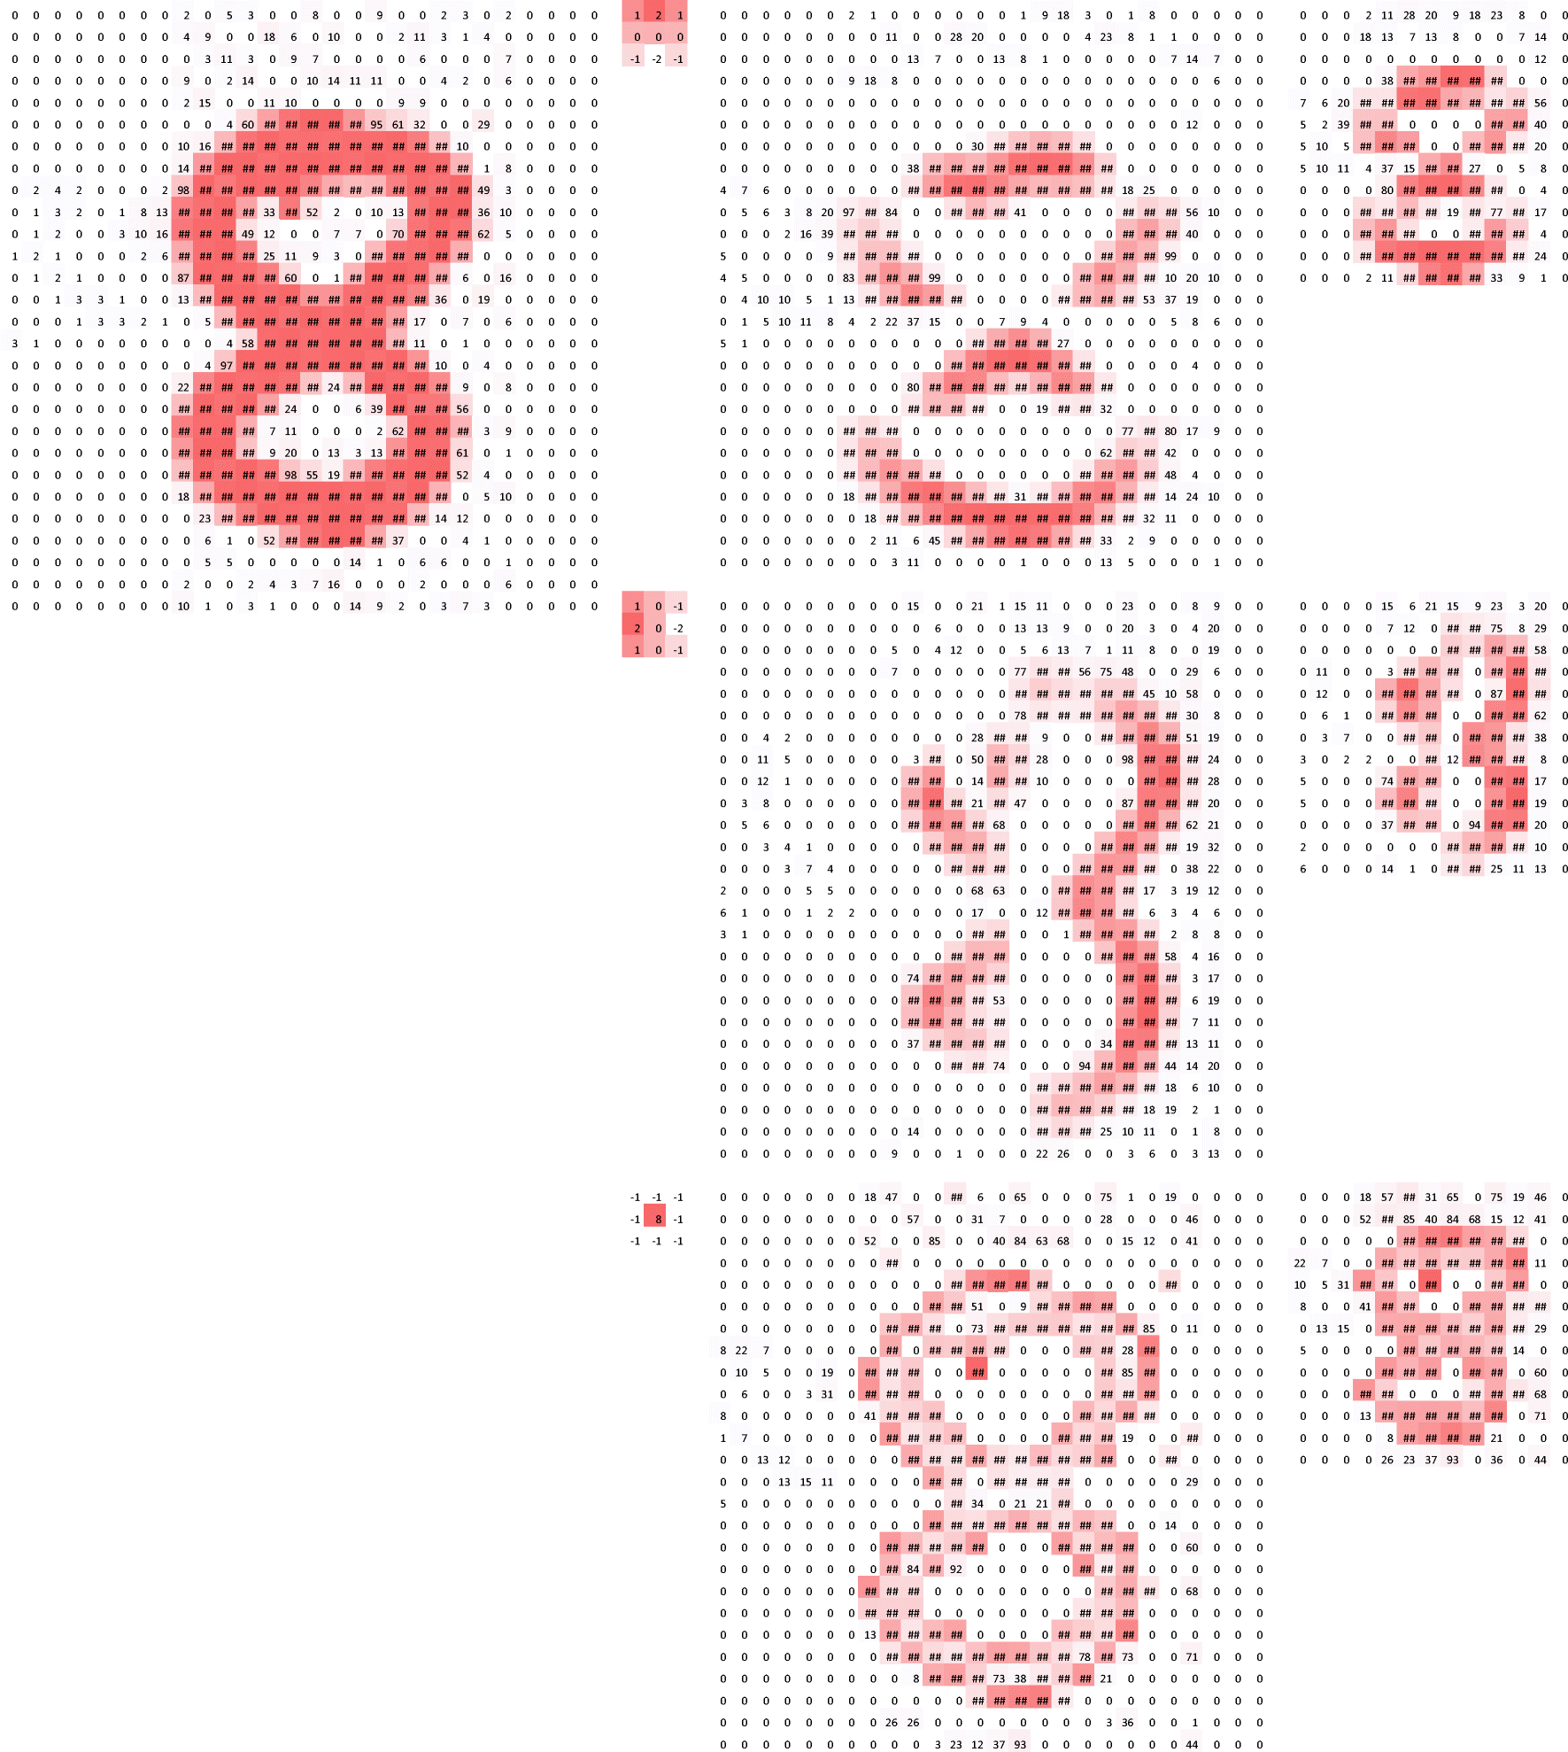
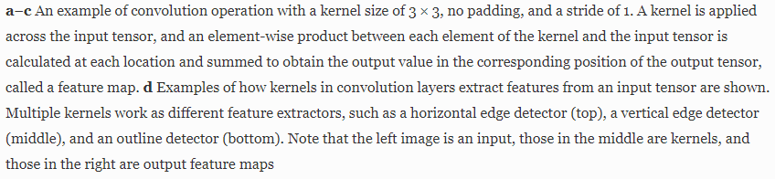
Methods
(Yamashita et al., 2018)
Notes:
https://link.springer.com/article/10.1007/s13244-018-0639-9

Slide 22

Methods
(Yamashita et al., 2018)
Notes:
https://link.springer.com/article/10.1007/s13244-018-0639-9

Slide 23


Methods
(Yamashita et al., 2018)
Notes:
https://link.springer.com/article/10.1007/s13244-018-0639-9

Slide 24
Methods: Hyperparameters
Function / Component | Purpose | In Our Model
Activation | To decide if the neuron would fire or not (transformation to input signal) | Conv2D: ReLU Dense: Linear
Optimizer | To update weights and biases to reduce the model’s error (non-linear). Lr is highly important here. | Adam
Loss | To calculate how well the model accomplishes its intended task (differences between actual and predicted values) | mean absolute error (mae)
Notes:
And just so you know, we used Adam that was largely recommended by data scientists including the Stanford Vision and Learning Lab as our optimizer and mae as loss function.
Adam was specifically claimed for working well with non-stationary objectives and sparse (noisy) gradients, while suitable for large datasets, and requires little tuning. Besides, the main point is it is supporting adaptive learning rate.
##############################################################################################################################################################################
https://towardsdatascience.com/adam-optimization-algorithm-1cdc9b12724a

Slide 25








Results: Our Model
0.00001 (1e-05)
Trend showing good lr
Small overfitting, high accuracy
Notes:
Based on our model, we realized that using 0.00001 (1e-05) as our initial learning rate would generate the best outcome.
For instance, when we were checking on the losses plots against epochs, they seems to be indicating a good lr, mse further validated this indication. The blue lines in the plots here representing the training dataset while the orange lines representing the testing dataset.
On the other hand, when we were looking at the accuracy plots, they showed a small overfitting and high accuracy, with the training dataset achieved more than 90% while the testing dataset achieved more than 80% starting around 70 epochs.
Subsequently, both the training and
Testing datasets showed good generalization (with evenly distributed prediction per indicated by the red dots, and low error per indicated by the density of the black line in the maps which linking the red predicted position dots with the blue actual position dots)
Also, when we tried to plot the XY Euclidean error with a cartesian to polar plot to have a clearer overview of the deviation between the actual and predicted value using the testing dataset, we observed that our model works well with very low error as shown by the dark purple dots which mainly clustered around 0, while the light purple dots also appeared to be spreading around all angles without clustering to specific angles which further validated by this histogram on the right
#################################################################################################################################
theta is radian(degree)-light purple, rho is the neuron activation-dark purple
x = real_xy[i][0]-pred_xy[i][0]
y = real_xy[i][1]-pred_xy[i][1]
theta = np.arctan2(y, x)
rho = np.hypot(x, y)

Slide 26




Results: Randomised Snapshots
Notes:
To check if our model learns correctly, we also shuffled the data by randomising the snapshots so that input and output were incorrectly matched.
As expected, we found that the model could not learn a representation of the Donderstown in such case.
This is because while the data were incorrectly matched, the model could not generalize a proper trend from the training to do a good prediction.

Slide 27

Results: Without Model Training
What if the good performance was just a luck
or the data is too simple to be interpreted ?!
Our model works!
Notes:
To further decide if our model actually providing significant effect on the data training, we also checked what will happen if we make prediction to the data without model training in advanced.
And we found that without any training, the dataset could not be properly predicted.
That means, our model works!
################################################################################################################################################################################
(the model predicted every output coordinate as (0,0), as there were no trained weights and bias values to calculate the potential output correctly)

Slide 28


Results: Percentage Splitting
Loss:
0.053
0.059
0.066
Validation Loss:
0.087
0.089
0.060
Accuracy:
0.932
0.922
0.911
Validation Accuracy:
0.875
0.881
0.913
~3%
~6%
~3%
~4%
<1%
<1%
Notes:
While we chosen to split our data as 50-50% in our model showcase, we have also tried to validate if this choice is good enough for model training when most data scientists would make it a 70-30 or 80-20 percent split for training-testing. To do this validation, we actually removed the angles criteria.
Looking at the loss values differences that were more or less the same, we deduced that 50-50 percent split is as good as different percentage split when the deviation is less than 10% in both losses and accuracies. And it is sufficient to let the model to learn a representation and to generalize per inspected.
#################################################################################################################################
The 80-20 percent model showed almost no overfitting or underfitting while our model of 50-50 showed slight overfitting and 20-80 percent model showed slightly higher overfitting.
This is because smaller percentage in training indicates less samples available and higher repetition during training, hence lower training errors (thus smaller training loss) and more overfitting (i.e. perform well on the training data but not over the testing data), thus poorer generalization in the testing set.
On the contrary, the 80% training set has more examples for the model to learn, it is thus able to estimate the testing set more easily.
While for our case, 50% seems to almost having just sufficient amount of examples to let the model to learn a representation and to generalize.
(but probably does not cover all features present in the testing set, which may lead to some small overfitting. In sum, the model needs sufficient training experience to generalize.)
20% train acc: 0.9315 vs 0.875, loss: 0.052986036129295824 vs 0.08672488359361887
50% train acc: 0.92225 vs 0.88125, loss: 0.05878835215047002 vs 0.0890963851325214
80% train acc: 0.91125 vs 0.912625, loss: 0.06600398900918662 vs 0.060305578945204615

Slide 29

Results: Training & Epochs
How good is our model?
Notes:
But one may wonder, how good is our model for such a complex data that involved large scales of coordinates and angles?
Based on our testing, I would consider it as very good.
It started to provide good estimates starting around 50 epochs, while further training slowly aids to decrease the loss values and increase the accuracy, hence improved generalization

Slide 30


Results: Learning Rate (lr)
0.92
0.84
0.0001 (1e-04)
vs
0.00001 (1e-05)
0.00001 (1e-05)
Notes:
And of course, we also compared which is the best initial learning rate for our model.
From the mse plots, we observed the ideal candidate could either be 0.0001 (1e-04) or 0.00001 (1e-05)
Hence, we double check over the accuracy plots, and 0.00001 indicated itself as the right candidate because it has high accuracy with the smallest overfitting in comparison.

Slide 31







Results: Peeking Insights
Decreasing mean gradient
What’s our Deep Neural Model’s
Relationship with Neuroscience?
Increasing mean gradient
Minor update to Figure 3.8(a) in my report to illustrate all sides of border for report coverage
Notes:
While not much persons have been trying to link and report the potential relationship between deep neural network and neuroscience, we did.
Considering that this project works on estimating the spatial representation of a virtual reality town,
we looked into the insight of how our deep neural network works to predict an output, wondering if there are some underlying spatial mechanisms involved that could be similar to the physiology experiments.
Interestingly, we found that our model mainly learnt through border-like units and corner-like units when we investigated the last hidden layer by retrieving the activation of each node (that stretched over) to all the positions before shrinking them into a squared bin of 2D histogram, and then further smoothed them using a Gaussian filter to reduce noises
The X and Y plots beside this activation map or we somehow called it as ratemap in neuroscience, are the mean values across the two axes respectively.
For example, looking at these 2 Y-axes, we can see that the gradients are decreasing, i.e. from high to low activations in the first one (thus having some negative values), while the second one is showing an incremental activation trend across the y-axis.
While for the corner units, this is something novel, it is unclear if the corner-like units co-exist with border cells in biological settings, such as inside the hippocampal-entorhinal circuit, but we suspect that they can play an equally important role as the border units if they do exist. As per speculated earlier in the report, maybe corner is a feature that exists preceding to the border such that the corner gets transform to the adjacent edge via a mechanism similar to the continuous attractor networks
And this is roughly how it looks like when we average the activations of all the 128 nodes of our model showcased to generate a single activation map
Additionally, we also found that the model needs at least two dense units to predict the outputs.
#################################################################################################################################
https://glassboxmedicine.com/2019/10/06/cnn-heat-maps-gradients-vs-deconvnets-vs-guided-backpropagation/
https://arxiv.org/pdf/1810.03292.pdf
Eyes: https://images.app.goo.gl/bv4k4qzWMbfhDx1i7

Slide 32

Discussion: Our Model & Suggestions
Learnability: Our deep neural network can learn the virtual environment
Good reliability: Low errors
High efficiency: At least two node units are needed to judge locations in the virtual environment
Border cells - key role in modulating and integrating the essential information to other spatial and directional cells?
Border = Edge, Adjoin
Differentiate & match objects;
prevent slipping in robots
Personal Suggestion [‘Outside In and then together They Link’]:
Corner / Border (Outline) > Points Connection (features & object recognition) > Judgement of Positions (Mapping)
Notes:
Based on our results, we deduced that our model can learn the virtual environment well with low errors and high efficiency.
In contrast, we wonder if biological neurons can be as efficient to judge and predict a full topographical map when being exposed to just half of the total data as there are lots of energy constraints in biological neurons such as firing factors, nutrients and oxygen supply and more.
Besides, based on our insights into the last hidden layer, we wonder if border cells are playing the key role in modulating and integrating the essential information to other spatial and directional cells?
For example, knowing that the term ‘border’ also carries the synonym as edge and adjoin, we deduced that border cells help both animals and robots in differentiating and matching objects, as well as prevent slipping in robots.
Say, maybe we all first recognize the corner and border of an object, then we learns the internal features of this object before we link the connection between objects into an experience map?
In a larger scale perspective, one may even speculate that with a good ability to judge the borders, lots of robots may soon overcome the obstacles and getting better in judging and climbing the staircases, such as the auto-cleaning robots or even an automatic wheelchair for the paralyzed patients.
#################################################################################################################################
(Our deep neural network was able to learn the virtual environment by analyzing the features of the inputs and storing them as different weights in the nodes, in combination with learning labels from the training dataset. The neural network eventually learned to compute the output for the testing dataset.)
Bottom Right: https://images.app.goo.gl/eSbZ1ffffBQRjYzw6

Slide 33
Discussion: Comparisons
Biological Settings | CNNs
Higher levels of complexity: - Highly specialised visual cells (Rods – achromatic, cones – chromatics; parvocellular – color contrast, spatial frequency; magnocellular – luminance contrast, temporal frequency; koniocellular – color selectivity and analysis; orientation selectivity: simple & complex cells; direction selectivity) | Interpretability over complexity: Have no different units to process black and white colors differently during visual perception Allow control of information such as the connectivity and activation of each node/layers, while also allowing one to perturb the units more easily and precisely
Saltatory propagation: Unidirectional action potentials Neurons are supplemented by glial cells | Feedforward and backpropagation: - Bidirectional
- Efficient in both power, elasticity and memory | - Limited by the hardware capacity, resource availability, and computational expense for large-scale analysis
Both of them are not completely understood in terms of internal computation processes (e.g. What makes the computer know 4 – 2 = 2?)
Notes:
In the meantime, I think it is also worth to mention that there are still challenges for simulated neural networks to fully reflect biological ones. Just taking the Convolutional Neural Networks (CNNs) that were inspired by neurobiology of visual cortex as an example. While the biological animals are possessing higher levels of complexity such as highly specialized visual cells with different functions, it is not the case for CNNs.
In contrast, CNNs are however allow the control of information such as the connectivity and activation.
On the other hand, while neurons in biological animals are undergoing unidirectional propagation, CNNs allow bidirectional information
Similarly, while biological neurons are considered as efficient in plasticity, memory and power such that we do not need a 240 volts to make the cells fire; CNNs are however limited by hardware capacity and resource availability, and can be highly expensive
But there is one similarity between both of them, we understand neither of their internal computation.
#################################################################################################################################
What does it mean as black-box process in term of the internal computation?
We can code algorithms and expect the result to be xxx. But we cannot exactly pinpoint how these algorithms communicate with the hardware into processing it. We have input and output, but we have no idea how the PC performed the magic.
Or putting in another way, how the PC knows exactly that subtraction is a process we minus a value, and how it do the subtraction when there is no physical representation such as apples for counting inside the PC. The understanding ability and performance of the PC here is the black box.

Slide 34


Slide 35
Future Directions: Basics
Alternate angles > 180° North/West vs. South/East
‘Lesioning’ some of the spatial inputs or altering the weights during model training
Test if data augmentation helps to improve the training
Test if the model can handle higher complexity of estimations such as including the angle as an output
(Playing with more variations of parameters such as different optimizers, activation and loss functions, etc.)
Notes:
Lastly, talking about the other potential works and possible extensions of this project in the future, I think we definitely can try out with:
Changing the angles selection for both the training and testing datasets
Adjusting the inputs’ weights
Expanding the training data with data augmentation
Including angles as extra output to be predicted by the model
And of course, playing with the parameters

Slide 36

Future Directions: Advanced
Alter the model architecture to decode on angle differences between separate snapshots
Can we discover biologically plausible solutions via this model? (E.g. replacing outputs XY with place cell activations and angles with head-direction activation)
Notes:
We can also modify the model architecture to decode angle differences between snapshots
In more advanced range, we can also try to:
Explore if we can discover biologically plausible solutions via this model such as replacing the outputs with physiological data for training.

Slide 37






Notes:
Well, I supposed this is the end of my presentation today.
#################################################################################################################################
Stars: https://images.app.goo.gl/NwPbHEBJyGg2paAq9
Good: https://images.app.goo.gl/iYHrcxLT1QKkBueu9
Thank you For Attention: https://images.app.goo.gl/Ltso1nhehhs2bZj97
Thinking: (Not sure which is the source anymore)
Yes: (Not sure which is the source anymore)
Pointing: (Not sure which is the source anymore)

Slide 38









Acknowledgement
Notes:
And I would like to take this opportunity to thanks whoever that has been paying his time and effort into reading and helping out with my works as well as supporting me, especially
Raphael, my PI who has always been super supportive, inspiring and motivating; and
Markus, my supervisor who gave me thorough supports and patience guidance throughout my whole master thesis; and finally
Tobias, for providing snapshots data and useful ideas and assistance.
#################################################################################################################################
Thank You: https://images.app.goo.gl/LPRWVqBg1oh9aofq8
Mushroom VR: https://images.app.goo.gl/WrotqfGkVyNZGny99
Handshake: https://images.app.goo.gl/8mLiW2uK35xbCtnK9
Hands-clapping/High-five: https://images.app.goo.gl/AC4DxZe6QocxMTnG8
Thank-you-hands: https://images.app.goo.gl/5dWibtmtd9u6mJF49
Hand-love: https://images.app.goo.gl/4yP4fha1hhHhhc2F6

